Slide 1
RFM Segmentation

Slide 2
Introduction

Slide 3
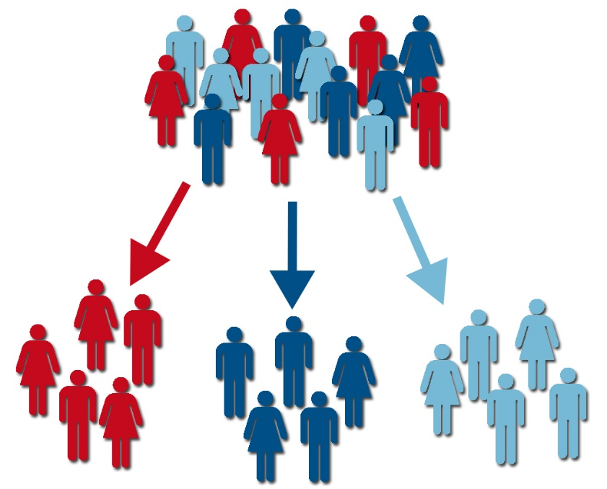
What is customer segmentation?
Customer segmentation is the process of organizing the customer base in small groups that share similar characteristics
Customers can be classified according to different criteria:
Transactional behavior
Interest categories
Products in common
This lecture

Slide 4
Basic R functions / dplyr

Slide 5


What is R?
1. | Statistical programming language created by NZ Researchers Ross Ihaka and Robert Gentleman in 1991.
2. | Derived from the S language, developed in the 1950's in Bell Labs.
3. | Free (both as in "free beer" and "free person") statistical package.
R is the language, Rstudio is the development environment / user interface to program in R. It’s recommended to install both (R first and then Rstudio)

Slide 6
Pros and cons
PROS
CONS
Simple to use
Extensive package library
Very good graphic libraries
R is not so good for intensive computations (all is done in-memory)
Packages not always play well with each other… be ware!

Slide 7
Coding time!
See 000_r_dplyr.R

Slide 8
K-means

Slide 9
What is k-means?
K-means is a clustering algorithm.
Clustering is the process or organizing data in groups that share certain similarities.

Slide 10
What does it do?
Choose k points from a given data set, randomly
For every point in the data set, calculate the similarity to all others, and assign each point to its closes center. The groups thus formed become the candidates for clusters.
For every new cluster, take the average of this points as a new “center” of the cluster and repeat step 2 until the total within-cluster square sum stops decreasing.
Notes:
K is the number of clusters, and needs to be “guessed” in advanced. More on that later.
“Similarity” can be chosen in different ways. It could be the correlation between two vectors, or in the case of text clustering, the cosine similarity.
The total within cluster sum of square is the sum of the distances from each point to its cluster center, and summed after across all clusters. The smallest this number is, it means that the data is “tight” and points are correctly assigned to their centers.

Slide 11
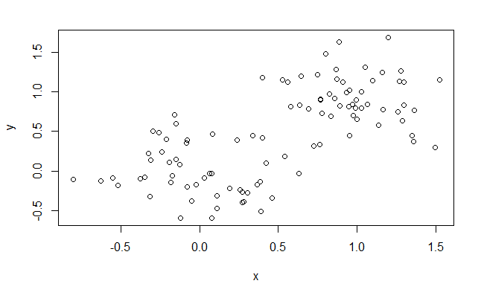
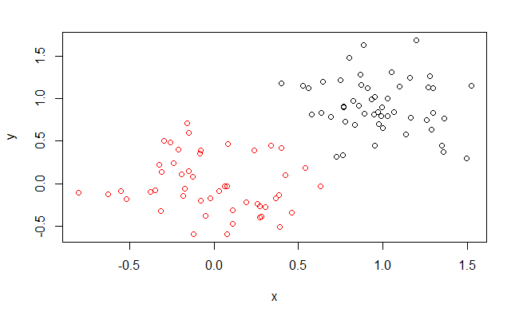
Example

Slide 12
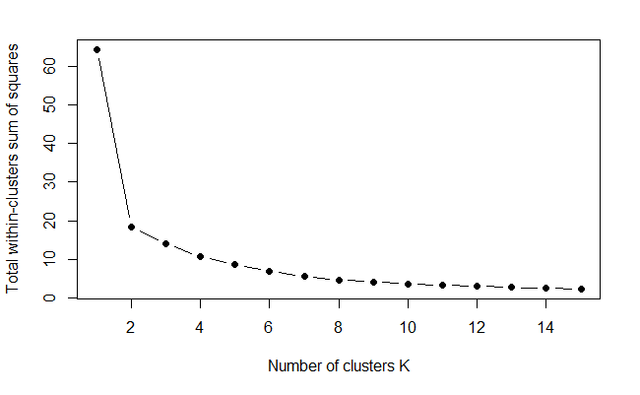
How many clusters are needed?
There are many methods to determine the number of clusters. The elbow method goes as follows:
Run k-means for different values of k
Store the total within cluster sum of squares
Create the plot on the left, and visually find the inflection point or “elbow” of the curve.

Slide 13
Workflow for RFM Segmentation

Slide 14
Steps
Basic customer summary:
Recency is the number of days since last purchase.
Frequency is the number of purchases.
Monetary is the total money spent.
1. | Create RFM summary
2. | Binning / discretizing variables
3. | Clustering
4. | Explain cluster results
This step is important to
Put all quantities in scale
Do segmentation with business meaning:
Big business difference between customers who spend 10 Euro vs those who spend 0; not so important between those spending 1000 Euro and 1010 Euro.

Slide 15
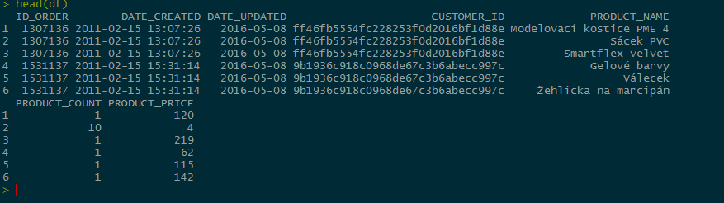
Step 0: Load transaction data
library(dplyr)
library(stringr)
df <- read.csv("./data/out.c- pa.orders_refine.csv",
encoding = "UTF-8")
head(df)
df$DATE_UPDATED <- as.Date(df$DATE_UPDATED)
#Assign a reference date for the analysis.
# This should be after the last date from the
# transaction history.
ref_date <- as.Date("2016-05-18")

Slide 16
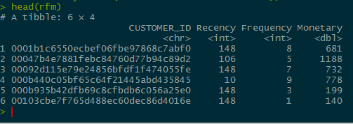
Step 1: RFM Summary
################################################ ## Step 1: RFM Summary ## ################################################
rfm <- df %>%
group_by(CUSTOMER_ID) %>%
summarise(
Recency=as.integer(difftime(ref_date,
max(DATE_UPDATED), units = "days")), Frequency = n(),
Monetary=sum(PRODUCT_COUNT*PRODUCT_PRICE))

Slide 17
Step 1: RFM Summary
################################################
## Step 2: Binning
################################################
rfm$rec_bin <- sapply(rfm$Recency, function(x){ifelse(x<50,1,ifelse(x<100,2,3))}) rfm$freq_bin <- sapply(rfm$Frequency, function(x){ifelse(x<1,1,ifelse(x<5,2,3))}) rfm$mon_bin <- sapply(rfm$Monetary, function(x){ifelse(x<300,1,ifelse(x<1000,2,3))})
# Get rid of NAs -- normally you would have
# to find out the cause of NAs from data
rfm <- na.omit(rfm)
data <- rfm %>% select(rec_bin, freq_bin, mon_bin)
Values on each segment obtained:
Visual inspection
Using quantiles
You can divide in more than 3 segments

Slide 18
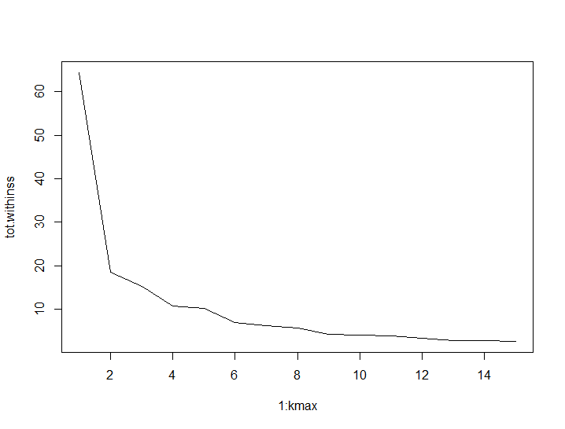
Step 3: Clustering
################################################
## Step 3: Clustering #
##############################################
## First we determine the maximum number
## of clusters
kmax <- 15
tot.withinss <- sapply(1:kmax,
function(k){
kmeans(data,k)$tot.withinss
})
plot(1:kmax, tot.withinss, type = "l")
# From the plot it seems like 8 is a reasonable choice
km <- kmeans(data,8) rfm$cluster <- km$cluster

Slide 19
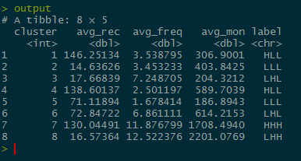
Step 4: Interpreting the results
################################################ ## Step 4: Interprete cluster # ############################################## m_rec <- mean(rfm$Recency)
m_freq <- mean(rfm$Frequency)
m_mon <- mean(rfm$Monetary)
output <- rfm %>%
group_by(cluster) %>%
summarise(avg_rec = mean(Recency), avg_freq = mean(Frequency), avg_mon = mean(Monetary)) %>% mutate(label = str_c(ifelse(avg_rec>m_rec, "H","L"), ifelse(avg_freq>m_freq, "H","L"), ifelse(avg_mon>m_mon, "H","L") ))

Slide 20
How to read the labels?
LHH: Diamond segment, our best customers
LHL: Frequent buyers, figure out what do they like and try to cross-sell something
LLH: Promising
LLL: Hard to assess
HHH: Sleeping beauties, good customers that need reactivation
HHL: Budget-conscious, worth reactivating if the goal is increase market share
HLH: Worth reactivating if the goal is to increase sales
HLL: Probably lost, may not be worth reactivating

